Slide 1
Bayesian assignment
Statistical solutions to research problems in psychology
Lecture 2
Rik Huijzer

Slide 2
This lecture
Recap lecture 1
Break
Bayesian assignment

Slide 3
Recap lecture 1
Slightly different angle:
generalize if you already got it last week
everything falls into place otherwise

Slide 4
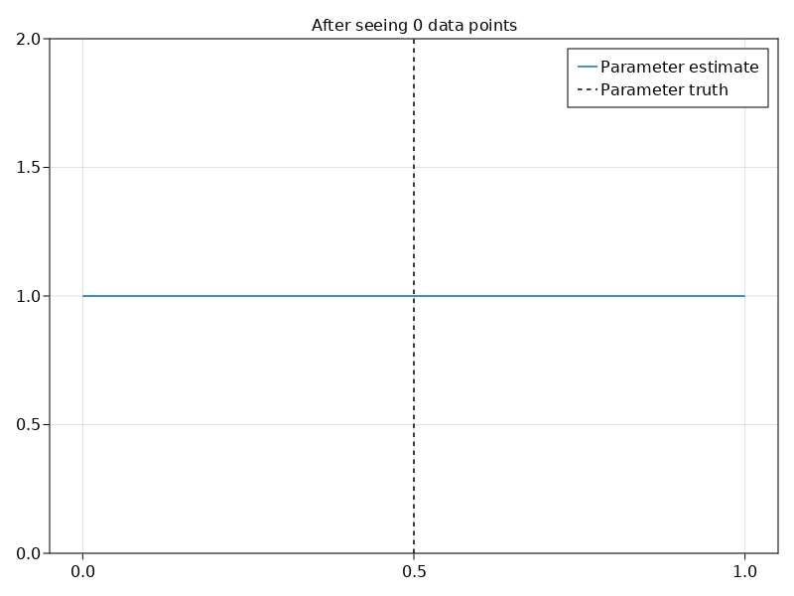

Slide 5
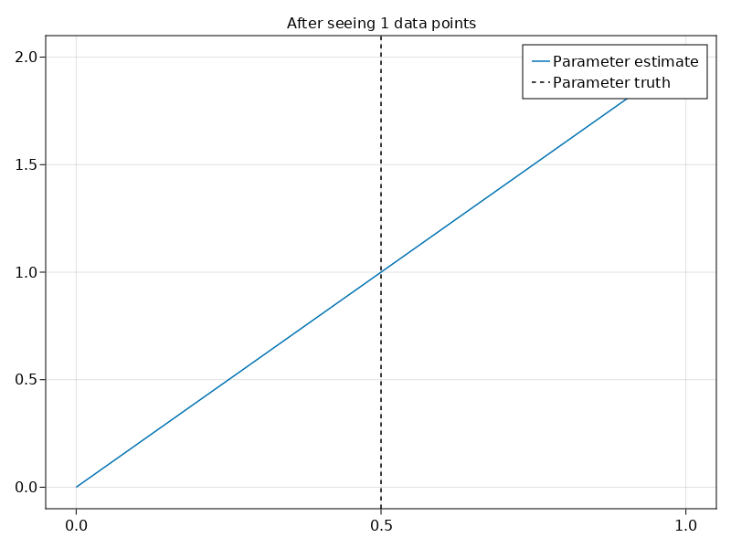

Slide 6
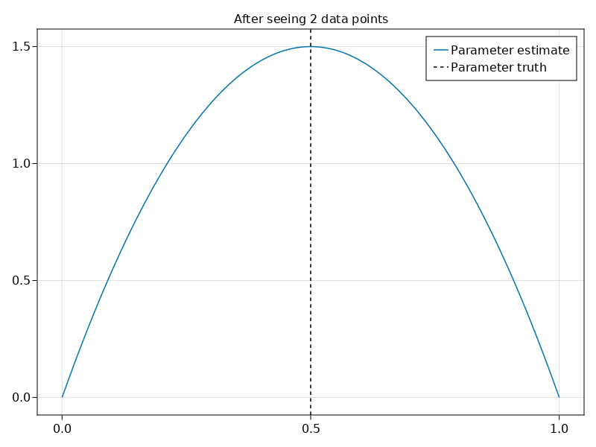

Slide 7
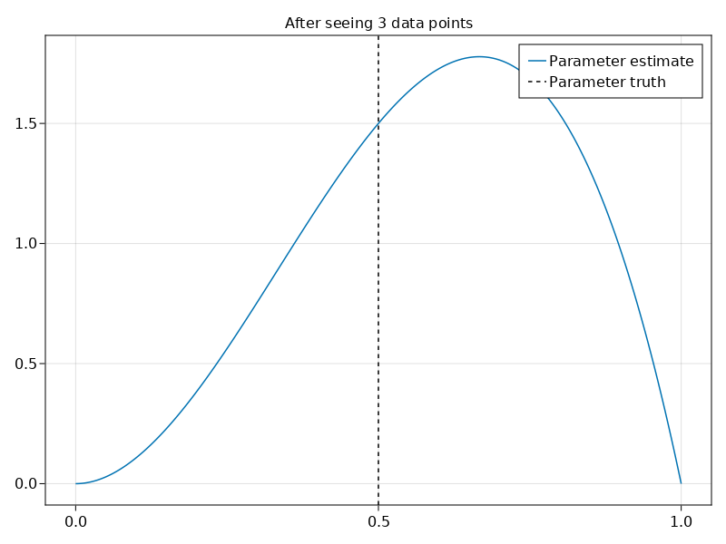

Slide 8
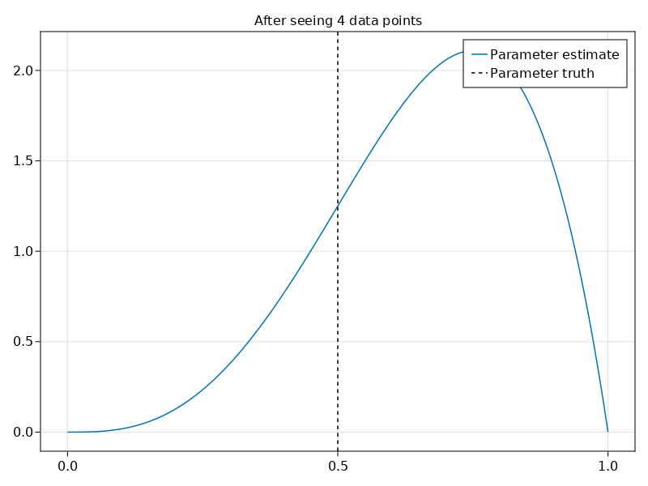

Slide 9
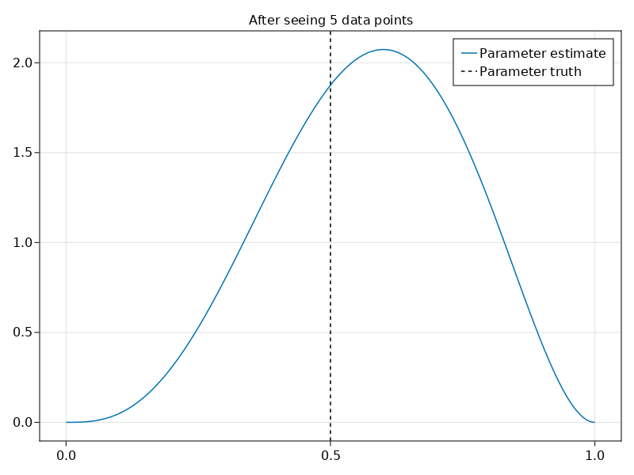

Slide 10
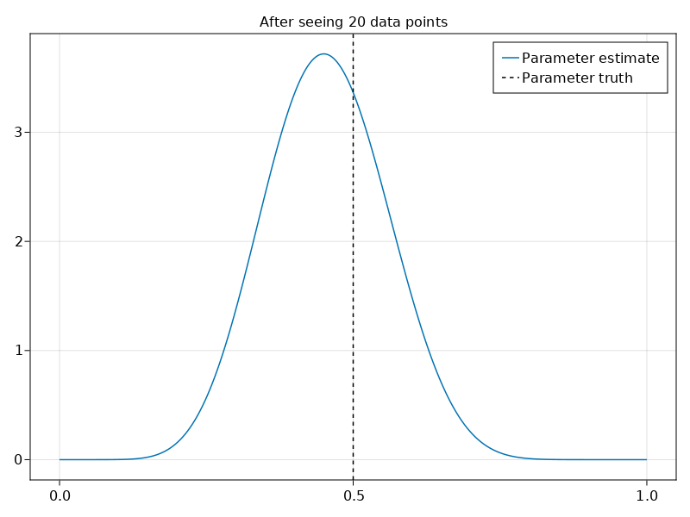

Slide 11
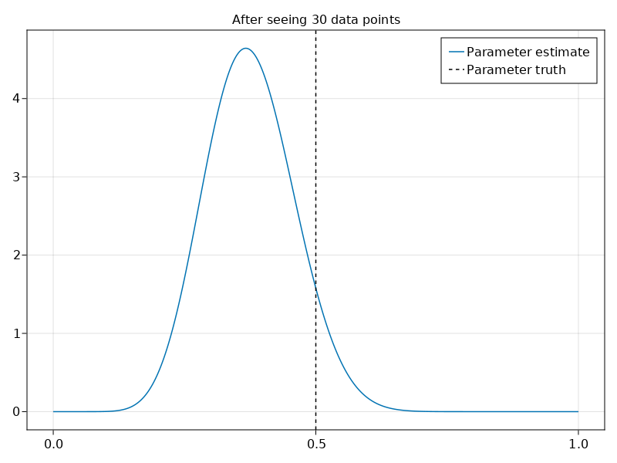

Slide 12
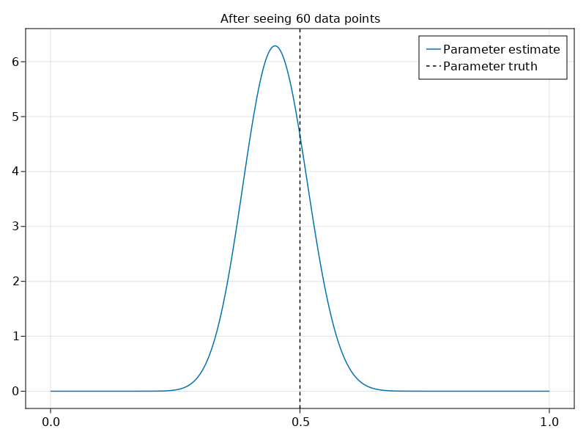

Slide 13
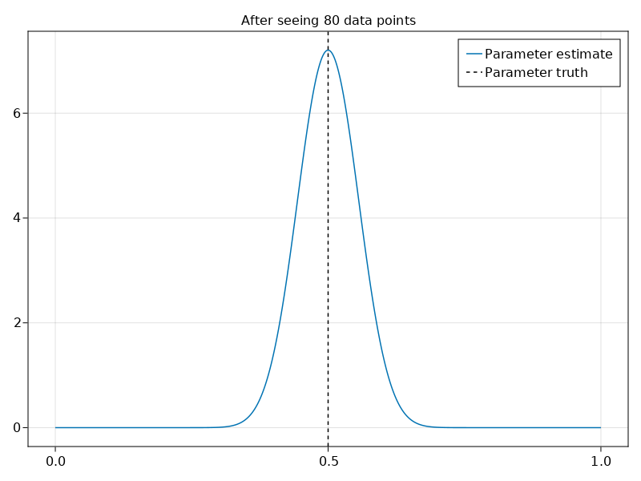

Slide 14
How would it look in the frequentist world?

Slide 15
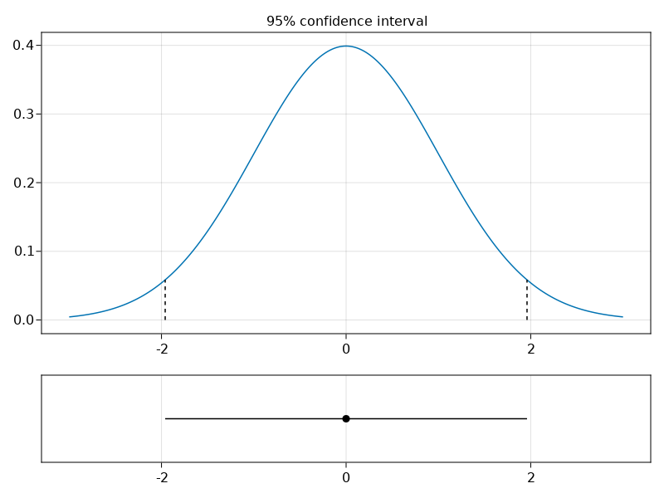
How would it look in the frequentist world?

Slide 16
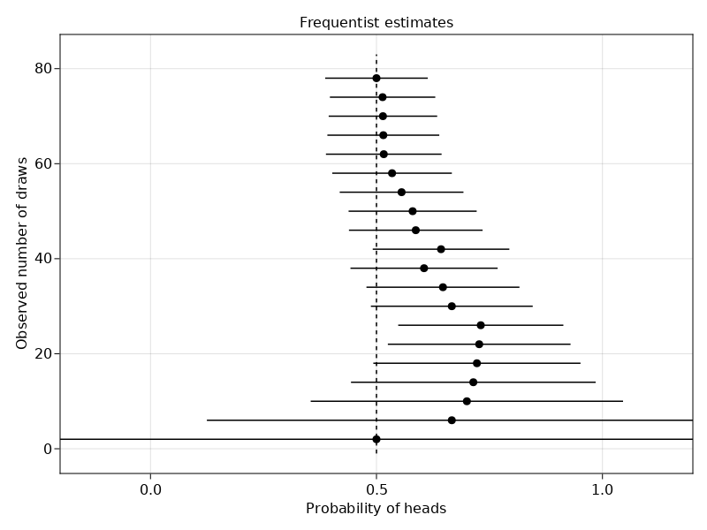
https://huijzer.xyz/posts/frequentist-bayesian-coin-flipping/

Slide 17
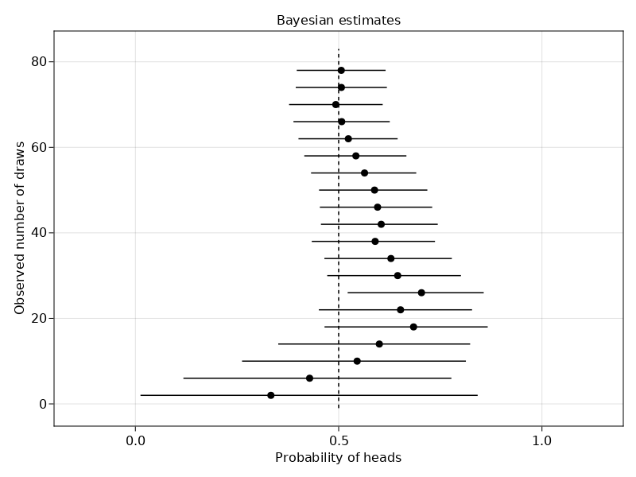
https://huijzer.xyz/posts/frequentist-bayesian-coin-flipping/

Slide 23


